Slide 1
Skin Cancer Detection
Pratik Salve

Slide 2
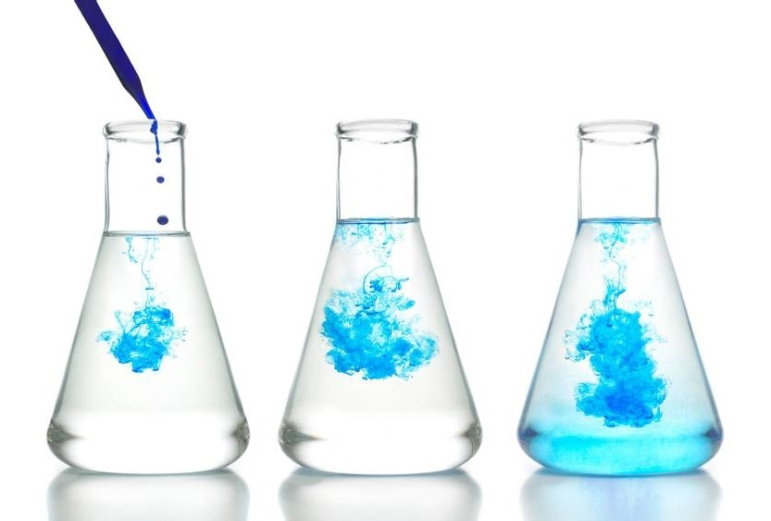
Contents
About Project
Overview of current situation
How DIP can overcome the issues
Working of system(code)

Slide 3

About Project
“Automated Classification of Skin Lesions Using Convolutional Networks and Digital Image Processing on the ISIC Dataset“
Objective:
To develop a deep learning-based image classification system that can accurately identify and categorize dermatoscopic skin lesion images into seven distinct categories, using the ISIC Skin Cancer dataset. The system leverages digital image processing techniques for image augmentation and preprocessing, and Convolutional Neural Networks (CNNs) for feature extraction and classification.

Slide 4
Overview of current situation
Skin cancer is one of the most common forms of cancer worldwide. Early detection and classification of skin lesions can significantly improve Treatments done on patient.
The identification is carried out by visual examination, potentially followed by a biopsy, and sometimes utilize dermoscopy.
Individuals can also perform regular self-exams to look for suspicious changes in moles or spots.

Slide 5
How DIP can overcome the issues
Image Enancement
Image normalization
Segmentation
Colour-space transform

Slide 6

Image enhancement
Purpose: Improves the visual quality of dermatoscopic images.
How: Techniques like contrast stretching, histogram equalization, or noise filtering are used to enhance lesion visibility.
Impact: Makes features like borders, asymmetry, and color variations more prominent for both human experts and AI models.

Slide 7
Image normalization
Purpose: Standardizes pixel values and image sizes.
How: Resizing all images to a fixed shape (e.g., 224x224) and normalizing intensity values (0–1).
Impact: Ensures consistent input to CNNs, avoids bias due to size or lighting, and speeds up learning.

Slide 8

segmentation
Purpose: Separates the lesion from surrounding skin.
How: Techniques like thresholding, region-growing, or advanced CNN-based segmentation (U-Net).
Impact: Focuses the model on the lesion area, improving classification accuracy and reducing background noise.

Slide 9
Colour-space transform
Purpose: Enhances color features important in lesion analysis.
How: Convert from RGB to other color spaces like HSV or LAB for better contrast and color segmentation.
Impact: Some lesion types (like VASC or BKL) have very specific color characteristics that become easier to analyze.

Slide 10

Working of system(code)

Slide 11
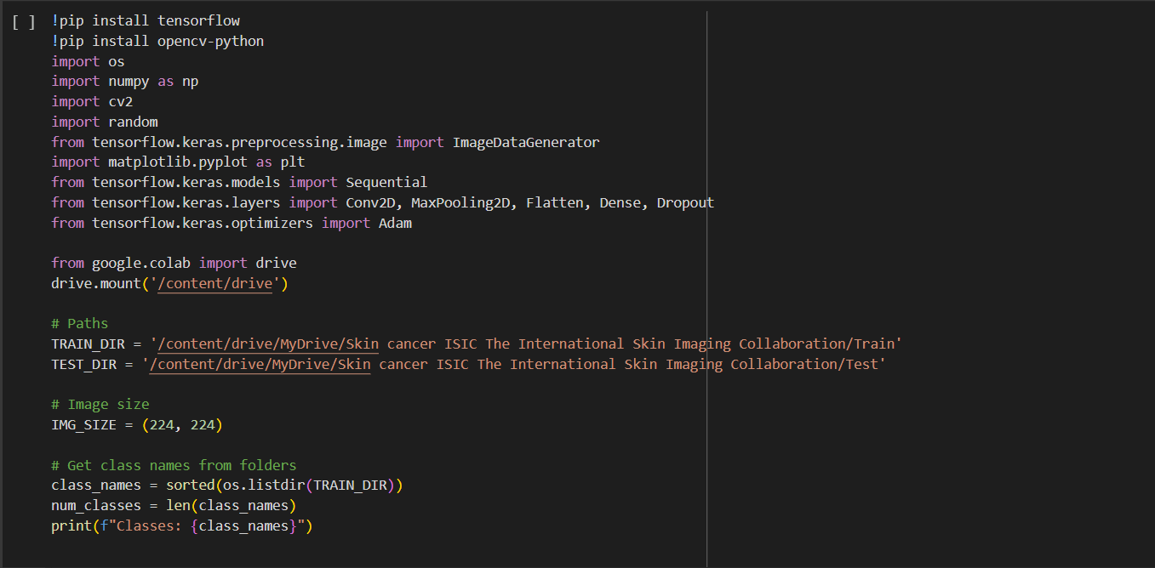
Import of libraries and dataset
https://www.kaggle.com/datasets/nodoubttome/skin-cancer9-classesisic/data

Slide 12
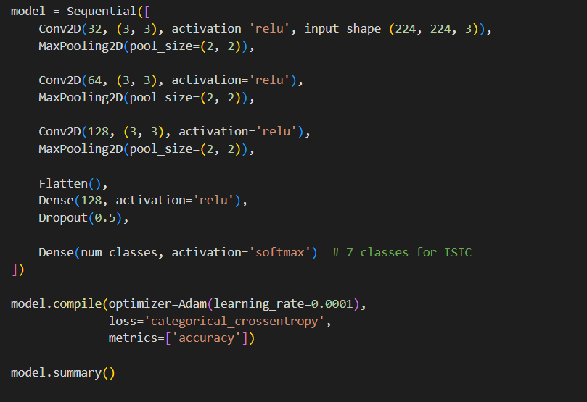
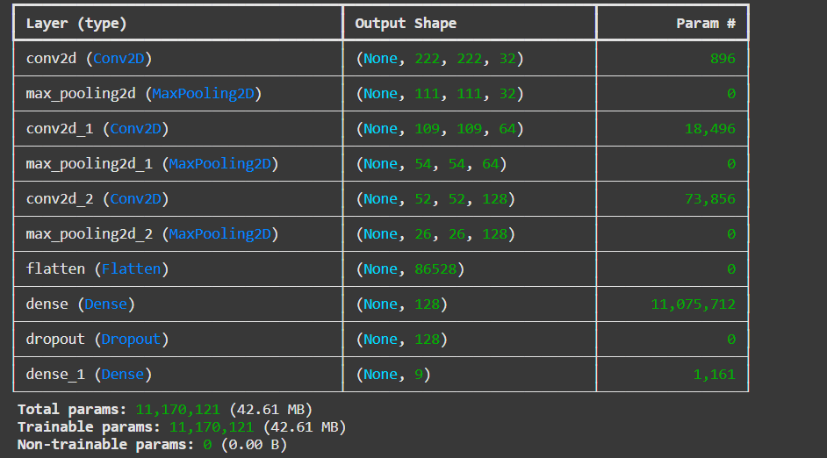
CNN model Architecture

Slide 13
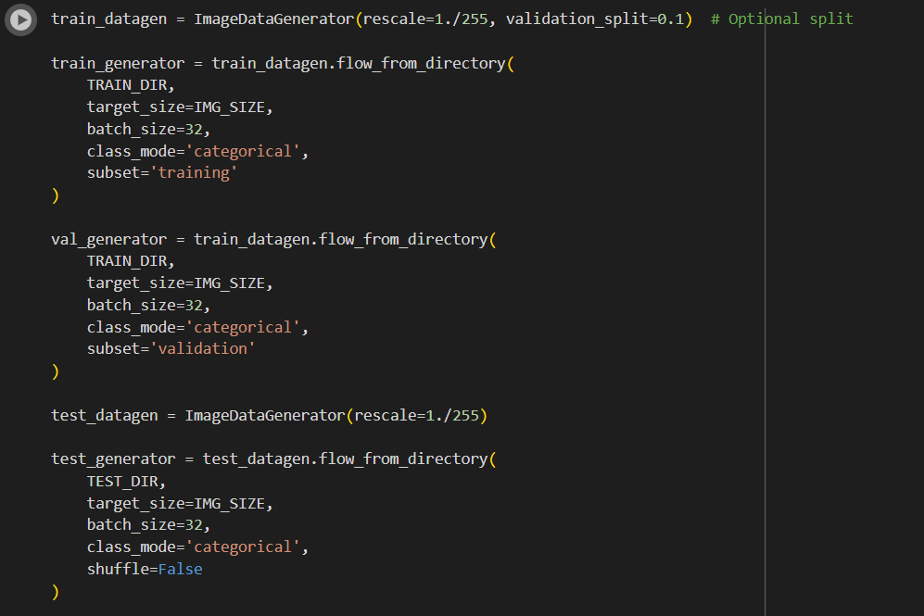
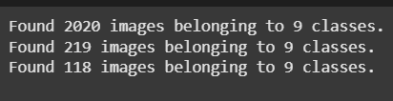
Data Generation

Slide 14
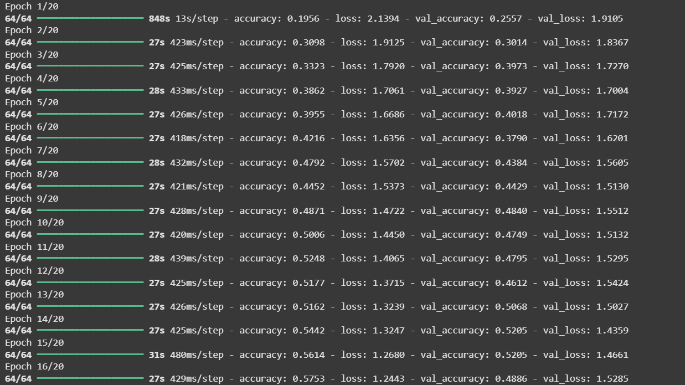
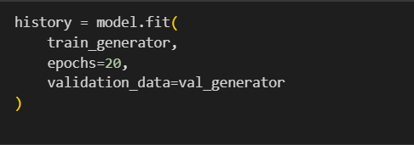
Model training

Slide 15
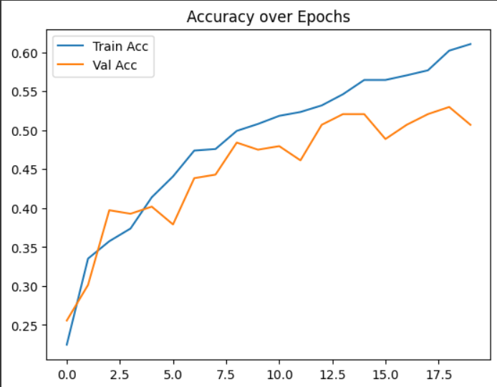
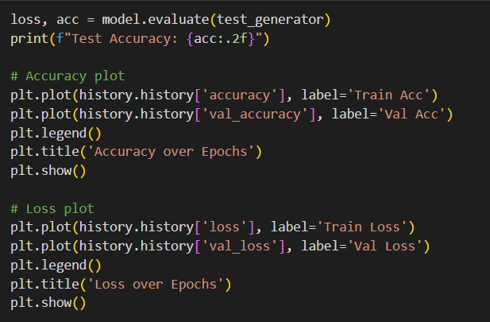
Accuracy plot

Slide 16
Concepts of DIP
Convolution Filtering :- concept used in image sharpening, edge detection (like Sobel, Laplacian).
Enhancement :- One of the key image enhancement techniques in Digital Image Processing (DIP).

Slide 17
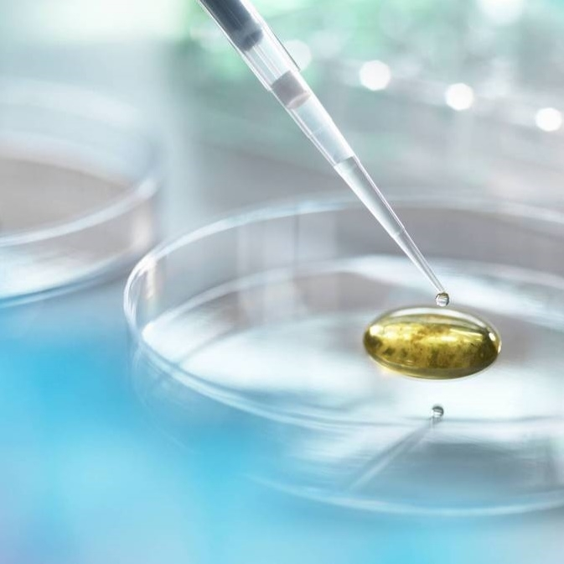
Thank you

